Slide 1
Microsoft Interview Coaching Program
Week # 5 – Data Structures (Lists, Queues, Stacks)

Slide 2
Agenda
Announcements
TEBOW IT Review of last week’s homework
This week’s lesson concepts
TEBOW IT - Hands-on Exercise
This week’s Homework

Slide 3
Announcements
Help make this program better!
Please fill out the mid-program survey
Learn how to get feedback without us
If you don’t get CR feedback, @mention someone until you do
Notes:
If you noticed we haven’t been providing as much code review feedback, that’s for good reason. We’re teaching you to find the resources you need to get feedback on your code
Important skill in industry – unblock yourself, get code reviews when you need it

Slide 4
Where are you getting stuck?
If you’re getting stuck at… | Then
T(alk) | Do mock interviews with a buddy
E(xamples) | Do more code reviews – it will make you a better tester
B(rute force) | Ask for hints or write more examples
O(ptimize) | You just need more practice/experience
W(alk through) | Do mock interviews with a buddy
I(mplement) | Write code (on a computer), every day
T(est/Debug) | Spend more time in the debugger and doing more code reviews
Notes:
Most commonly, you will get stuck at O and I

Slide 5
Last week’s homework problem
Word Break
Given an input string and a dictionary of words, find out if the input string can be segmented into a space-separated sequence of dictionary words.
For example, consider the following dictionary: { pear, salmon, foot, prints, footprints, leave, you, sun, girl, enjoy },
Examples:
Given the string “youenjoy”,
Output: True (The string can be segmented as “you enjoy”)
Input: “youleavefootprints”,
Output: True (The string can be segmented as “you leave footprints” or “you leave foot prints”)
Input:salmonenjoyapples
Output: False

Slide 6
Function signature
public bool WordBreak(string input, HashSet<string> wordDict)

Slide 7
T – Talk (/Listen/Clarify)
Question | Answer
How to handle invalid input? | Exception for null input string or null dictionary, false for empty string or empty dictionary
Does case matter? i.e., “Hello”, “hello” same word? | Case insensitive
Can the same dictionary word appear multiple times in the input string? | Yes
Can the input string have special characters? | No, only alphabet characters (a..zA..Z)
Can we use library functions (in string and regex)? | Yes
Is the order of the input string enforced? | Yes, no shuffling of characters in the input string to match words in the dictionary

Slide 8
E – Examples (/Test/TDD)
Sample Input | Equivalence Class | Output
Null input string or null dictionary | Invalid input | Throw exception
Empty input string or dictionary with no elements | Empty inputs | False
“a”, {“a”} | Single element success | True
“a”, {“b”} | Single element failure | False
“ab”, {“ab”} | Simple case success | True
“ab”, {“de”} | Simple case failure | False
“abcd”, {“ab”, “cd”} | More than one matching word | True
“cars”, {“car”, “cab”} | Some words match but can’t find all matches | False
“cars”, {“car”, “ca”, “rs”} | Some words match, but have to look at other words for all matches | True
"aaa…(many more a’s)…aaaaaaab“, { "a", "aa", "aaa", "aaaa", "aaaaa", "aaaaaa", "aaaaaaa", "aaaaaaaa", "aaaaaaaaa", "aaaaaaaaaa" } | Evil? | False
Notes:
Discussion: Why did we decide to throw exception for null but not for empty dictionary?

Slide 9
B – Brute Force, Option 1
Check for invalid input and return
Find every single way you can break up the input string
For each possible set of word breaks
Return true if the set of possible word breaks matches words in the dictionary
Time complexity: O(2^{n} * m)
n = length of input string
m = length of word dictionary

Slide 10
How did we arrive at O(2^{n} * m)?
N = length of input string
N = 1 (“a”) | N = 2 (“ab”) | N = 3 (“abc”) | N = 4 (“abcd”)
“a” | “ab” “a b” | “abc” “ab c” “a bc” “a b c” | “abcd” “a bcd” “abc d” “ab cd” “ab c d” “a bc d” “a b cd” “a b c d”
1 possibility | 2 possibilities | 4 possibilities | 8 possibilities
= 2⁰ | = 2¹ | = 2² | = 2³

Slide 11
Another approach
Check for invalid input and return
Loop over the length of the string
Start from position 0, and move forward in the input until you find a match in the dictionary
If you reached the end and didn’t find a match, return false
If you found a match, repeat this same algorithm for the remaining portion of the input string (i.e. recursive call)
Complexity
Time: O(2^{n})
Space: O(n²)

Slide 12
Example
Input: “carsgofast”, {“cars”, “go”, “fast”}
Now repeat the same process with “gofast”, recursively
Iterative substring | Rest of input string | Is substring in dictionary?
“c” | “arsgofast” | No
“ca” | “rsgofast” | No
“car” | “sgofast” | No
“cars” | “gofast” | Yes!
Notes:
We must start at position 0 to find a match
If we’ve reached the end of the string and we don’t have a match, then return false (no word could be matched)

Slide 13
Worst case example
Input: “aaaab”, {“a”, “aa”, “aaa”, “aaaa”}
Iterative substring | Rest of input string | # of recursive calls for rest of string
“a” | “aaab” | 4
“aa” | “aab” | 3
“aaa” | “ab” | 2
“aaaa” | “b” | 1
“aaaab” | “” | 0
Notes:
The running time is much worse with this example

Slide 14
Space: O(n²)
Iterate through the entire string of length n
For index i < n, we may need to make n-i-1 recursive function calls
In the worst case for a string of length n, we will make this many recursive function calls:
(n-1) + (n-2) + (n-3) + … + 2 + 1
= sum of integers from 1 to n
= n(n+1)/2
= n²
The lookups for the words in the dictionary are O(1)

Slide 15
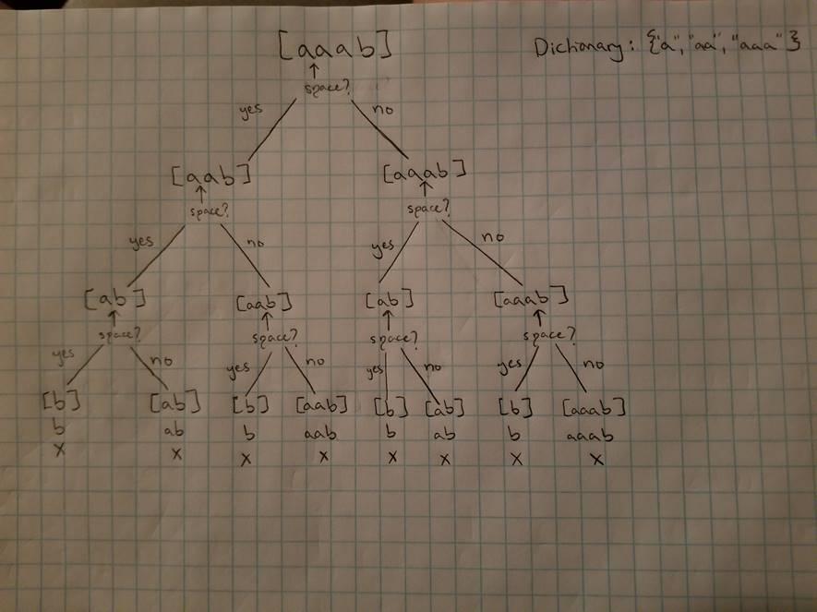
Time: O(2^{n})
Notes:
Notice how we are doubling the work at each level
If we count the number of O(1) lookups, we can see 2^n
“aaab”
Is “a” in dictionary? Yes, recursively call function for “aab”
Is “a” in dictionary? Yes, recursively call function for “ab”.
Is “a” in dictionary? Yes, recursively call function for “b”.
Is “b” in dictionary? No
Is “ab” in dictionary? No
Is “aa” in dictionary? Yes, recursively call function for “b”
Is “b” in dictionary? No
Is “aab” in dictionary? No
Is “aa” in dictionary? Yes, recursively call function for “ab”
Is “a” in dictionary? Yes, recursively call function for “b”.
Is “b” in dictionary? No
Is “ab” in dictionary? No
Is “aaa” in dictionary? Yes, recursively call function for “b”.
Is “b” in dictionary? No
Is “aaab” in dictionary? No

Slide 16
public static bool WordBreakRecursive(string input, HashSet<string> wordDict)
{
if (input == null || wordDict == null)
{
throw new ArgumentNullException();
}
for (int i = 0; i < input.Length; i++)
{
string firstWordCandidate = input.Substring(0, i + 1);
if (wordDict.Contains(firstWordCandidate))
{
if (i == input.Length - 1)
{
return true;
}
string restOfInput = input.Substring(i + 1, input.Length - (i + 1));
if (WordBreakRecursive(restOfInput, wordDict))
{
return true;
}
}
}
return false;
}

Slide 17
O - Optimize
O(2^{n}) is slow, can we explore an iterative solution?
Idea: keep track of all possible word break indices

Slide 18
Iterative Algorithm
Idea: keep track of all possible word break indices
Suppose a word starts at index i at index j, in the input string
A word break is true at position j if and only if:
i == 0 (i.e., it’s the first word in the string), OR
There is a word break at index i – 1 (i.e., this word immediately follows previous word break)
When we get to the end of the string, if we encountered a word break at the last index in the string, we return true
Notes:
The last sentence here is important – if you work your way backwards from the end of the string to the beginning, by virtue of our definition of something being a word break, it must hold true that the entire string has word breaks if the last index represents a word break.

Slide 19
Example
Input: “carsgofast”, {“cars”, “go”, “fast”}
Word break indices: 0, 3, 5, 9

Slide 20
W – Walk Through
Check for invalid input and return
Loop over the length of the string
At each position (i) in the input string
Loop over the words in the dictionary
Check if the word matches the substring at position i + length of the word
If there’s a match, record the ending word break position from the string, only if
i == 0, OR, we recorded a word break at index i - 1
When we get to the end of the string, if we encountered a word break at the last index in the string, we return true
Complexity
Time: O(m*n), n = length of input string, m = length of word dictionary

Slide 21
I - Implement

Slide 22
public static bool WordBreak(string input, HashSet<string> wordDict)
{
if (input == null || wordDict == null)
{
throw new ArgumentNullException();
}
if (String.IsNullOrEmpty(input) || wordDict.Count == 0)
{
return false;
}
bool[] wordBreakIndices = new bool[input.Length];
for (int i = 0; i < input.Length; i++)
{
foreach (string word in wordDict)
{
if (i + word.Length <= input.Length)
{
string wordToCompare = input.Substring(i, word.Length);
if (String.Compare(wordToCompare, word, StringComparison.OrdinalIgnoreCase) == 0 &&
(i == 0 || wordBreakIndices[i - 1]))
{
wordBreakIndices[i + word.Length - 1] = true;
}
}
}
}
return wordBreakIndices[input.Length - 1];
}

Slide 23
T - Test
See E – Examples slide

Slide 24
Data Structures
Linked lists, stacks, queues

Slide 25
Tips for data structure questions
Draw pictures – almost impossible to solve otherwise
Ask clarifying questions about the data structure
Do we know how many elements?
What type of data does it hold?
Is the data sorted?

Slide 26
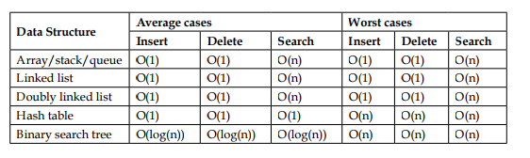
Big O for Data Structures
Notes:
Don’t memorize the list – instead be able to reason through how you arrive at the complexity for each operation

Slide 27
Resources for data structures
https://www.quora.com/Which-is-the-best-online-course-to-learn-data-structures
http://www.geeksforgeeks.org/
https://visualgo.net/en
Notes:
GeeksForGeeks seems particularly useful

Slide 28
Linked Lists

Slide 29


Linked Lists – Visual Representation
Singly linked list
Doubly linked list
Circular linked list
Notes:
Explain the concept of a “node”, it has next (and in some cases ‘previous’) pointers to other nodes, and stores data of some type

Slide 30
Advantages and applications of Linked Lists
Dynamic memory allocation
No wasted memory
No need to resize data structure as you go (i.e. unlike an array)
O(1) insertion and O(1) deletion
Depends on where you’re inserting or deleting
May be used as an underlying implementation of other abstract data types
Notes:
Disadvantages? Finding an element can be expensive

Slide 31
Basic Linked List Questions
Write a function to insert a node in a singly linked list
Write a function to remove a node from a singly linked list
Note: doubly linked list questions are uncommon since they vastly simplify the problem
Adding a node to head/tail/middle of list
Removing a node to head/tail/middle of list
Notes:
Good clarifying questions are where to add/remove the node (head? Tail? Middle?)

Slide 32
Resources for Linked Lists
https://www.cs.cmu.edu/~adamchik/15-121/lectures/Linked%20Lists/linked%20lists.html
https://en.wikipedia.org/wiki/Linked_list

Slide 33
Stacks

Slide 34
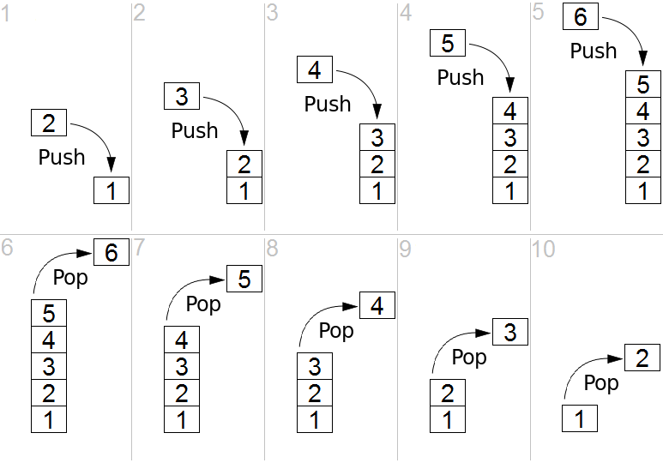
Stacks – Visual Representation
Notes:
Stacks are often visualized growing from the bottom up (like real-world stacks). They may also be visualized growing from left to right, so that "topmost" becomes "rightmost", or even growing from top to bottom.

Slide 35
Advantages and applications of Stacks
O(1) insertion and O(1) deletion
Depends on where you’re inserting or deleting
“LIFO” (Last In First Out) is useful for ordered, temporary storage. Examples:
Reversing a word
Recursion
"Undo" operation in text editors (push each change into the stack)

Slide 36
Basic Stack Questions
Implement a basic stack
Push, Pop, Peek, IsEmpty
Implement a stack using an array
Implement a stack using a singly linked list
Notes:
Key concept: stack is an *abstract* data type – the operations should be the same, irrespective of the underlying implementation

Slide 37
Resources for Stacks
https://en.wikipedia.org/wiki/Stack_(abstract_data_type)
https://www.cs.cmu.edu/~adamchik/15-121/lectures/Stacks%20and%20Queues/Stacks%20and%20Queues.html

Slide 38
Queues

Slide 39
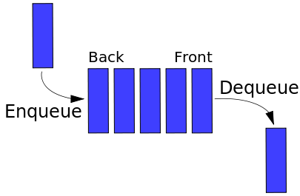
Queues – Visual Representation
Notes:
Stacks are often visualized growing from the bottom up (like real-world stacks). They may also be visualized growing from left to right, so that "topmost" becomes "rightmost", or even growing from top to bottom.

Slide 40
Advantages and applications of Queues
O(1) insertion and O(1) deletion
“FIFO” (First In First Out) is useful when entities are processed in the order they are received
Message queues

Slide 41
Queue
Implement a basic queue
Enqueue
Dequeue
Implement a queue using a dynamic array
Implement a queue using a doubly linked list
Implement a queue using a singly linked list
Notes:
Key concept: stack is an *abstract* data type – the operations should be the same, irrespective of the underlying implementation

Slide 42
Resources for Queues
https://en.wikipedia.org/wiki/Queue_(abstract_data_type)
https://www.cs.cmu.edu/~adamchik/15-121/lectures/Stacks%20and%20Queues/Stacks%20and%20Queues.html

Slide 43
Hands On Exercise

Slide 44
Mth to last element in linked list
Given a singly linked list, devise a time and space efficient algorithm to find the mth-to-last element of the list.
Notes:
Unfortunately we don’t have time to do a deep dive on other data structures in class today.
Linked list questions show up often during interviews

Slide 45
T – Talk (/Listen/Clarify)
Question | Answer
Invalid input handling? | Return null
What is the “0th“ to last element in the list? | The last element in the list
Can we use additional data structures? | Interviewer’s choice
What type of data will be stored? | Interviewer’s choice – could impact your solution based on the size of the data
How big can the data structure be? | Interviewer’s discretion

Slide 46
E – Examples (/Test/TDD)
Input m^{th} to last | Input List | Equivalence Class | Output
Any value | Null | Invalid input | Throw exception
3rd to last | ‘a’ -> ‘b’ |  | Return null
0th to last | ‘a’ | Simple case | Return element ‘a’
1st to last | ‘d’ -> ‘b’ -> ‘a’ | Simple case, success | Return element ‘b’
2nd to last | ‘b’ -> ‘a’ | Simple case, failure | Return null
2nd to last | ‘c’ -> ‘b’ -> ‘a’ | Boundary | Return element ‘c’
0th to last | ‘c’ -> ‘b’ -> ‘a’ | Boundary | Return element ‘a’

Slide 47
B – Brute Force, Option 1
Traverse m elements forward in the list from the first element
If we’re at the end of the list, we’ve found our m^{th} to last element
If not, move forward one position, and repeat this process
Complexity: O(m*n)
Notes:
Remember there is no way to move backwards in a singly linked list
10 elements, find 5th to last

Slide 48
Option 2 – use additional data
Store some of the elements (or pointers to the elements) as you traverse the list
When you hit the end of the list, traverse back m elements in your copy of the list
Time Complexity: O(n)
Space Complexity: O(n)
Notes:
For example, you could push each of the elements onto a stack, and then at the end of traversing, you pop m elements from your stack

Slide 49
Option 3 – use additional data, but less ☺
Assume the list is of length n, and we wish to find the mth to last element
An element that is mth to last must also be j elements from the beginning
So j + m = n, and j = n – m
We can count all the elements in the list (n), and then traverse the list up to j
Time Complexity: O(n + n - m) => O(2n - m) => O(n)
Space: negligible, only some simple variables
Notes:
Requires a second pass through the list, if m is small this is almost an entire pass through the list

Slide 50
Option 4
Consider having two pointers to traverse the list
Advance the current pointer m elements ahead (make sure there are m elements in the list first!)
Maintain another pointer “mBehind”, that is always m elements behind the current pointer
Advance both pointers simultaneously until current points to the end of the list
At this point, the “mBehind” pointer is pointing to the mth to last element!
Time Complexity: O(n + n - m) => O(2n - m) => O(n)

Slide 51
Example: 2nd to last
(m = 2, list contains 5 elements)

Slide 52
mBehind, current start at beginning
mBehind, current

Slide 53
Move current m elements ahead
mBehind
current

Slide 54
Move both ahead while current->next not null
mBehind
current

Slide 55
If current is at last element, mBehind points to the m^{th} to last
mBehind
current

Slide 56
I - Implement
https://github.com/careercup/CtCI-6th-Edition-CSharp/blob/387d92270427b077ef1115de17cb3d70ec3a7791/Ch%2002.%20Linked%20Lists/Q2_02_Return_Kth_To_Last.cs
Can you think of ways to improve the code?

Slide 57
T - Test
See E – Examples slide

Slide 58
This week’s homework assignment
Implement a function to check if a linked list is a palindrome

